Slide 1

UWROV CS Introduction

Slide 2
What is programming?
A program is a set of computer instructions.
Note that computer programming is different from mathematical programming.
In the context of the United States military during World War II, programs are “proposed schedules of training, logistical supply and development of combat units.” It is this military definition that is used when referring to the mathematical programming, which is today used in the fields of industrial engineering and economics.
Ironically, the problems that are the focus mathematical programming are computationally heavy and almost exclusively solved using computer programs (it is commonplace to have problems programming progamming problems, that’s not the focus of these slides).

Slide 3
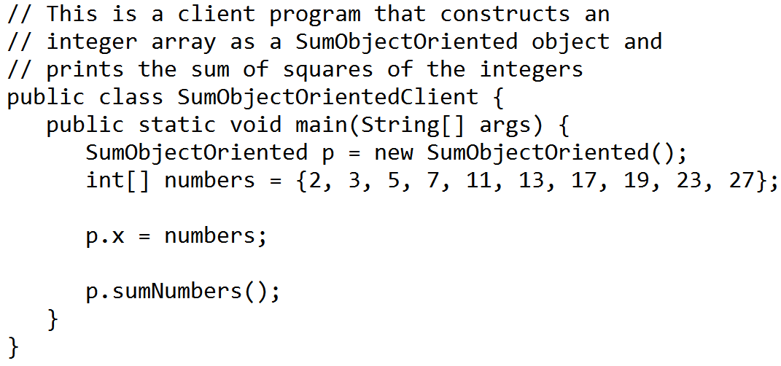
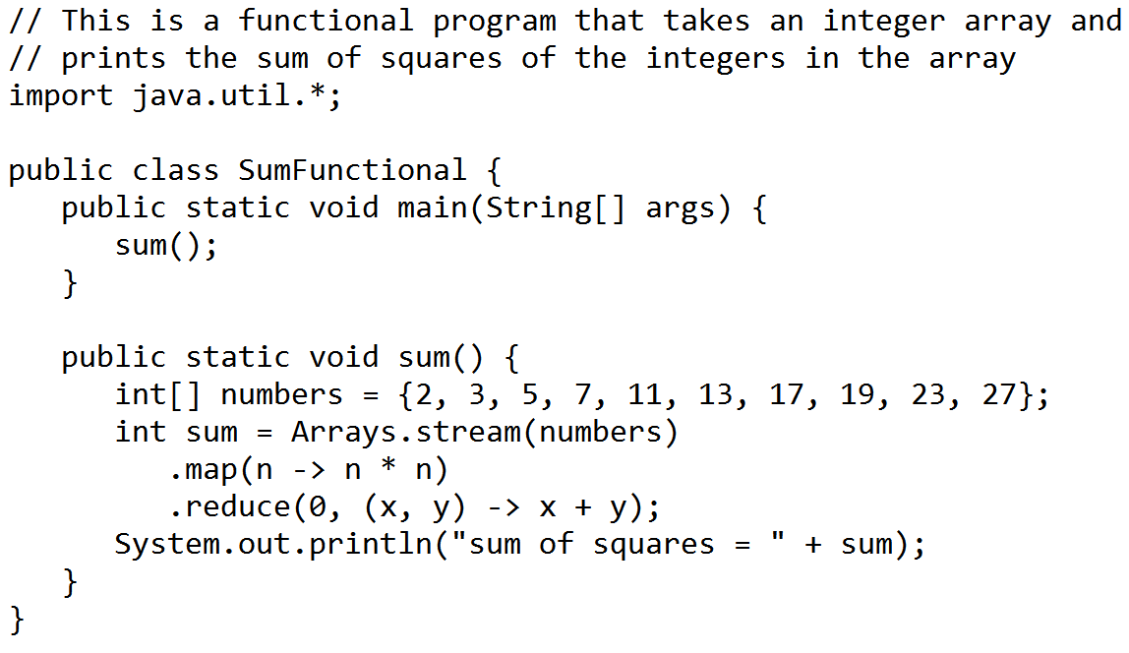
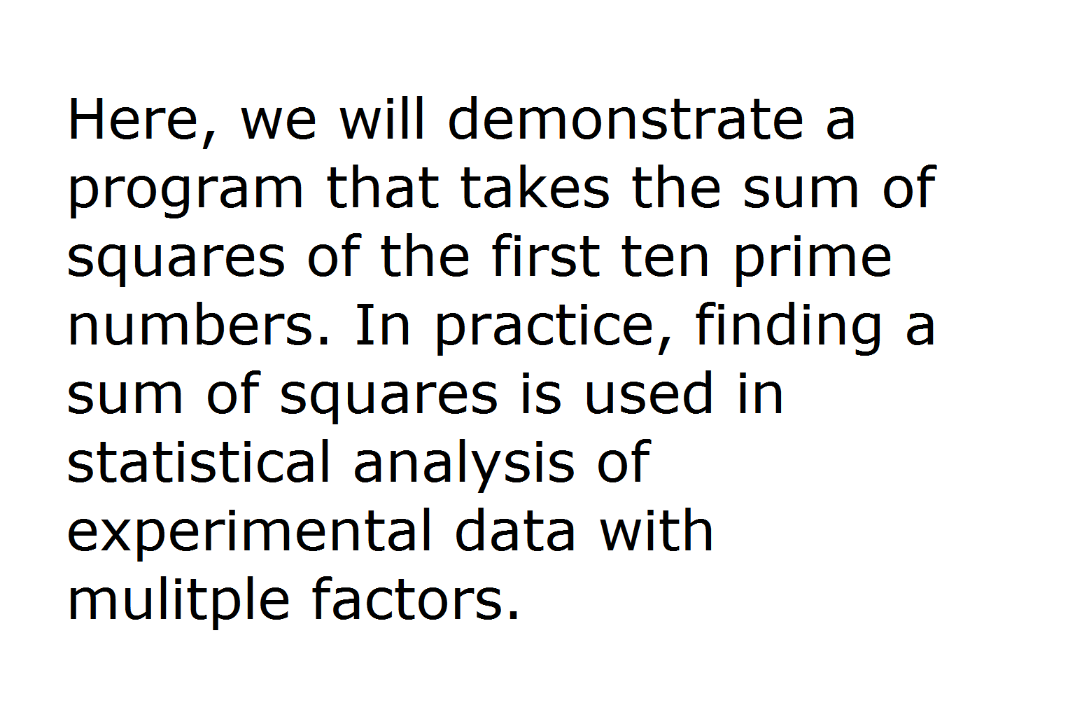
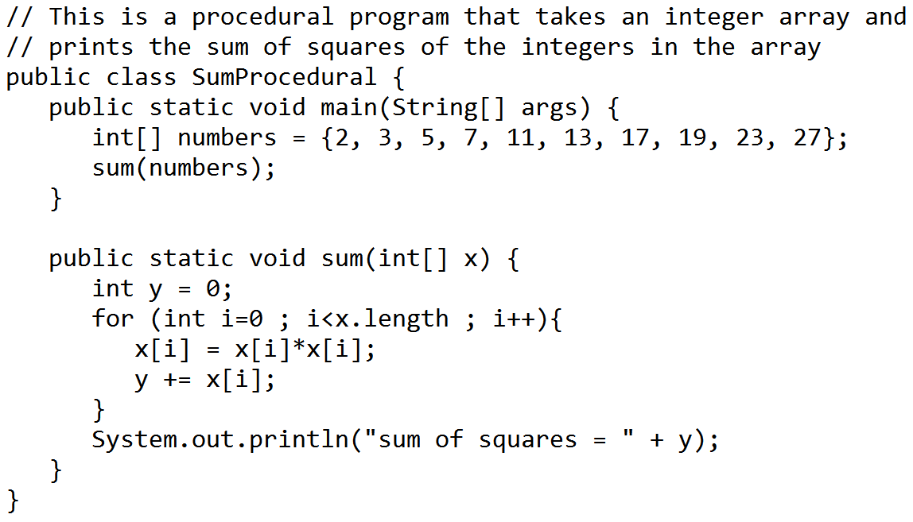
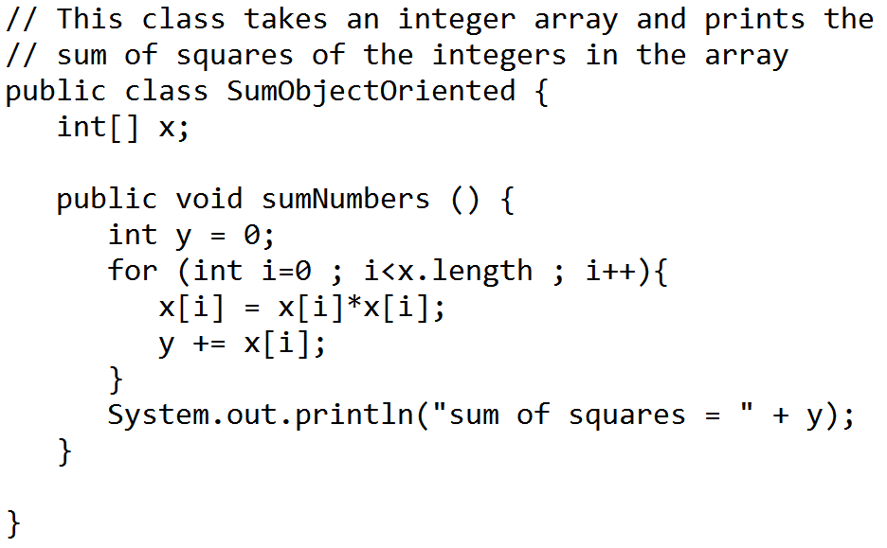
Programming Paradigms
A paradigm is a style of programming, a way of going about to solve a problem.
Procedural programming is analogous to a “verb noun” construction: delete this file where this file is the parameter. This is easy to understand because languages such as English, French and Mandarin use a subject-verb-object construction. One way to remember this is by thinking of the lyrics to Daft Punk’s “Technologic”: Write it, cut it, paste it, save it.
Object-oriented programming reverses this construction, so you start with a parameter: take this file, and delete it. Object oriented programs present a more intuitive way of doing things, and is used today when you drag a file icon to the “Recycle Bin” icon on a PC desktop. An object, like the file icon, encompasses state and behavior. The construction of lines in an object-oriented language is analogous to languages like Latin, German and Japanese which use a subject-object-verb construction. (Thus the state motto of Alabama, “Audemus jura nostra defendere”, literally “our rights we dare to defend” becomes “we dare to defend our rights” when used in the English subject-verb-object construction.) Our song lyrics would be: “It write, it cut, it paste, it save.”
One simple explanation of an object is given in Michael Crichton’s Jurassic Park (1990):
In computer terminology, an “object” was a block of code that could be moved around an used, the way you might move a chair in a room. An object might be a set of commands to draw a picture, or to refresh the screen, or to perform a certain calculation.
Functional programming passes functions as parameters, so many actions can be performed in series While earlier programs were either functional or not, most languages today incorporate functional constructs. Java 8, Scala (a derivative of Java) and Python are examples of languages that incorporate functional constructs. In a functional paradigm, our song lyrics become “It: write, cut, paste, save” which isn’t quite as poetic.
One benefit of functional programming is that it makes parallel computing easier to code (programs run faster if they use multiple cores on a dual-core or quad-core computer).
↑
These are two separate files
↓

Slide 4
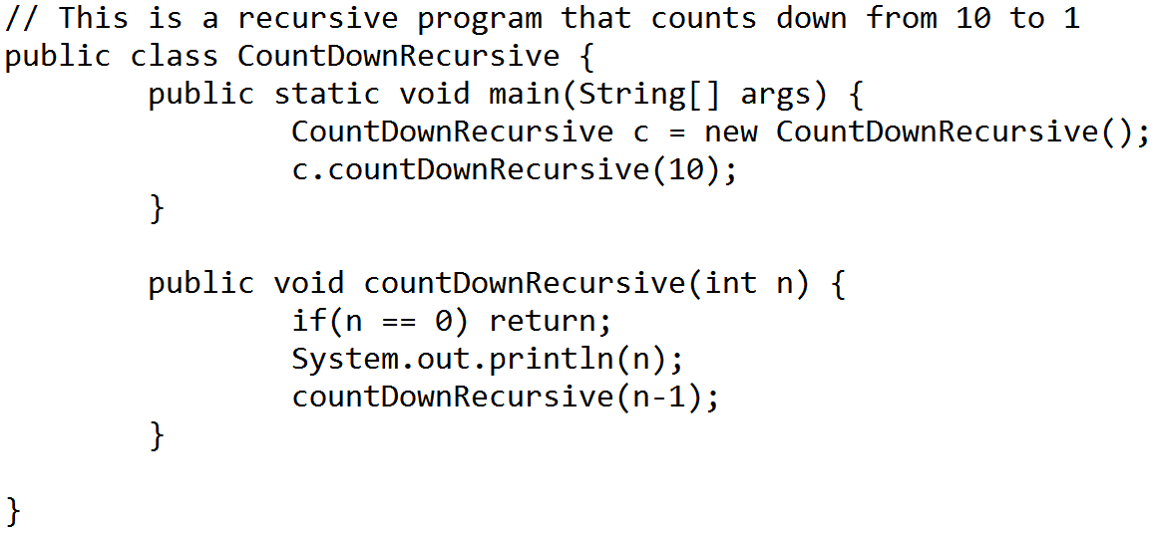
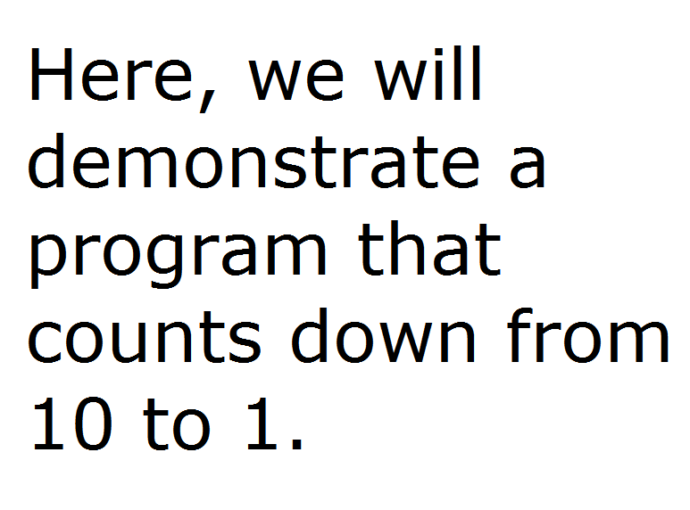
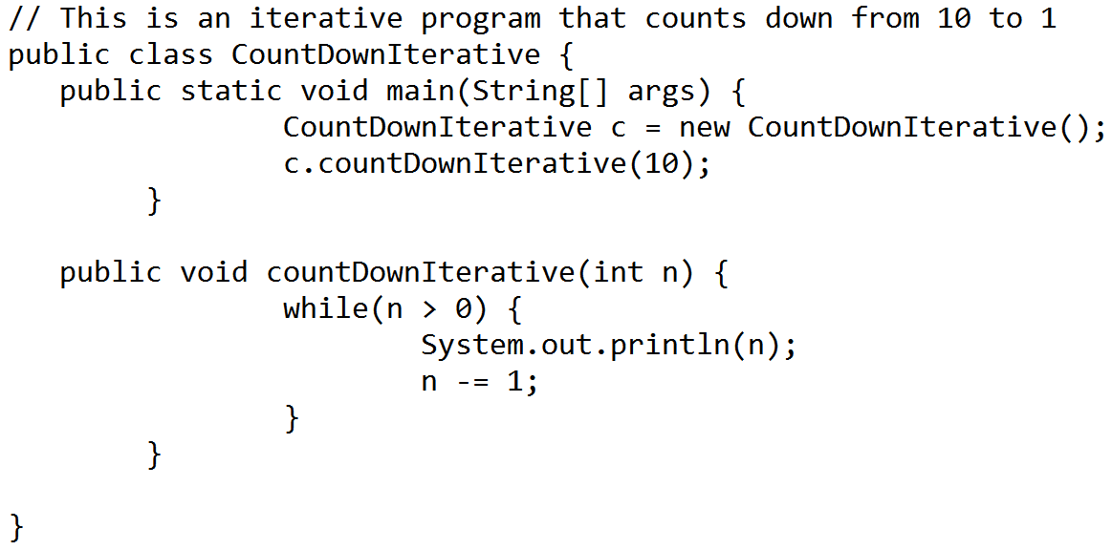
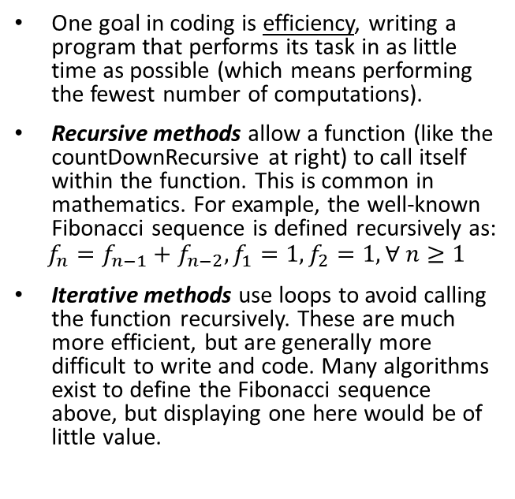
What differentiates good coding from bad?
One goal in coding is efficiency, writing a program that performs its task in as little time as possible (which means performing the fewest number of computations).
Recursive methods allow a function (like the countDownRecursive at right) to call itself within the function. This is common in mathematics. For example, the well-known Fibonacci sequence is defined recursively as:
$$f_{n}=f_{n−1}+f_{n−2}, f_{1}=1, f_{2}=1,∀ n≥1$$
Iterative methods use loops to avoid calling the function recursively. These are much more efficient, but are generally more difficult to write and code. Many algorithms exist to define the Fibonacci sequence above, but displaying one here would be of little value.

Slide 5
One common question that everyone on the team should be able to answer: Why did we pick that language or software?

Slide 6

Java
A May 2017 poll ranks Java as the world’s most popular programming language (see here https://www.tiobe.com/tiobe-index/)
Java is designed for object-oriented programming, and derived most of its syntax from C and C++.

Slide 7
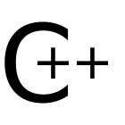
C
C, and its derivatives C++ and C# (pronounced C Sharp, not C Hashtag or C Pound) rank 2nd, 3rd and 5th, respectively, in May 2017 popularity, making the C family of languages as popular as Java.
C was originally a procedural programming language, and was developed in the 1970s. C++ and C# are multiparadigm, general-purpose programming languages.

Slide 8

Python
Python ranks 4th in terms of popularity.
Python is a modern procedural language (but has functional constructs in it).
Python was designed to be easy to read and easy to write (for example, using words rather than punctuation to denote ranges), and is optimized for clarity rather than speed.
Python uses indentation for delimiting, making the code clean looking and concise.

Slide 9
Other miscellaneous and useful software that might come up for miscellaneous tasks
SolidWorks is used for CAD modeling and is used in ME 123.
Simio is used for simulation and is used in IND E 424.
LaTeX is for document preparation language used in AMATH 383.
Matlab is used for scientific computing and taught in AMATH 301.
R is open-source and used to for statistics, and is used in several informatics and statistics classes.
AMPL is used to solve mathematical programing problems and is used in IND E 412.

Slide 10
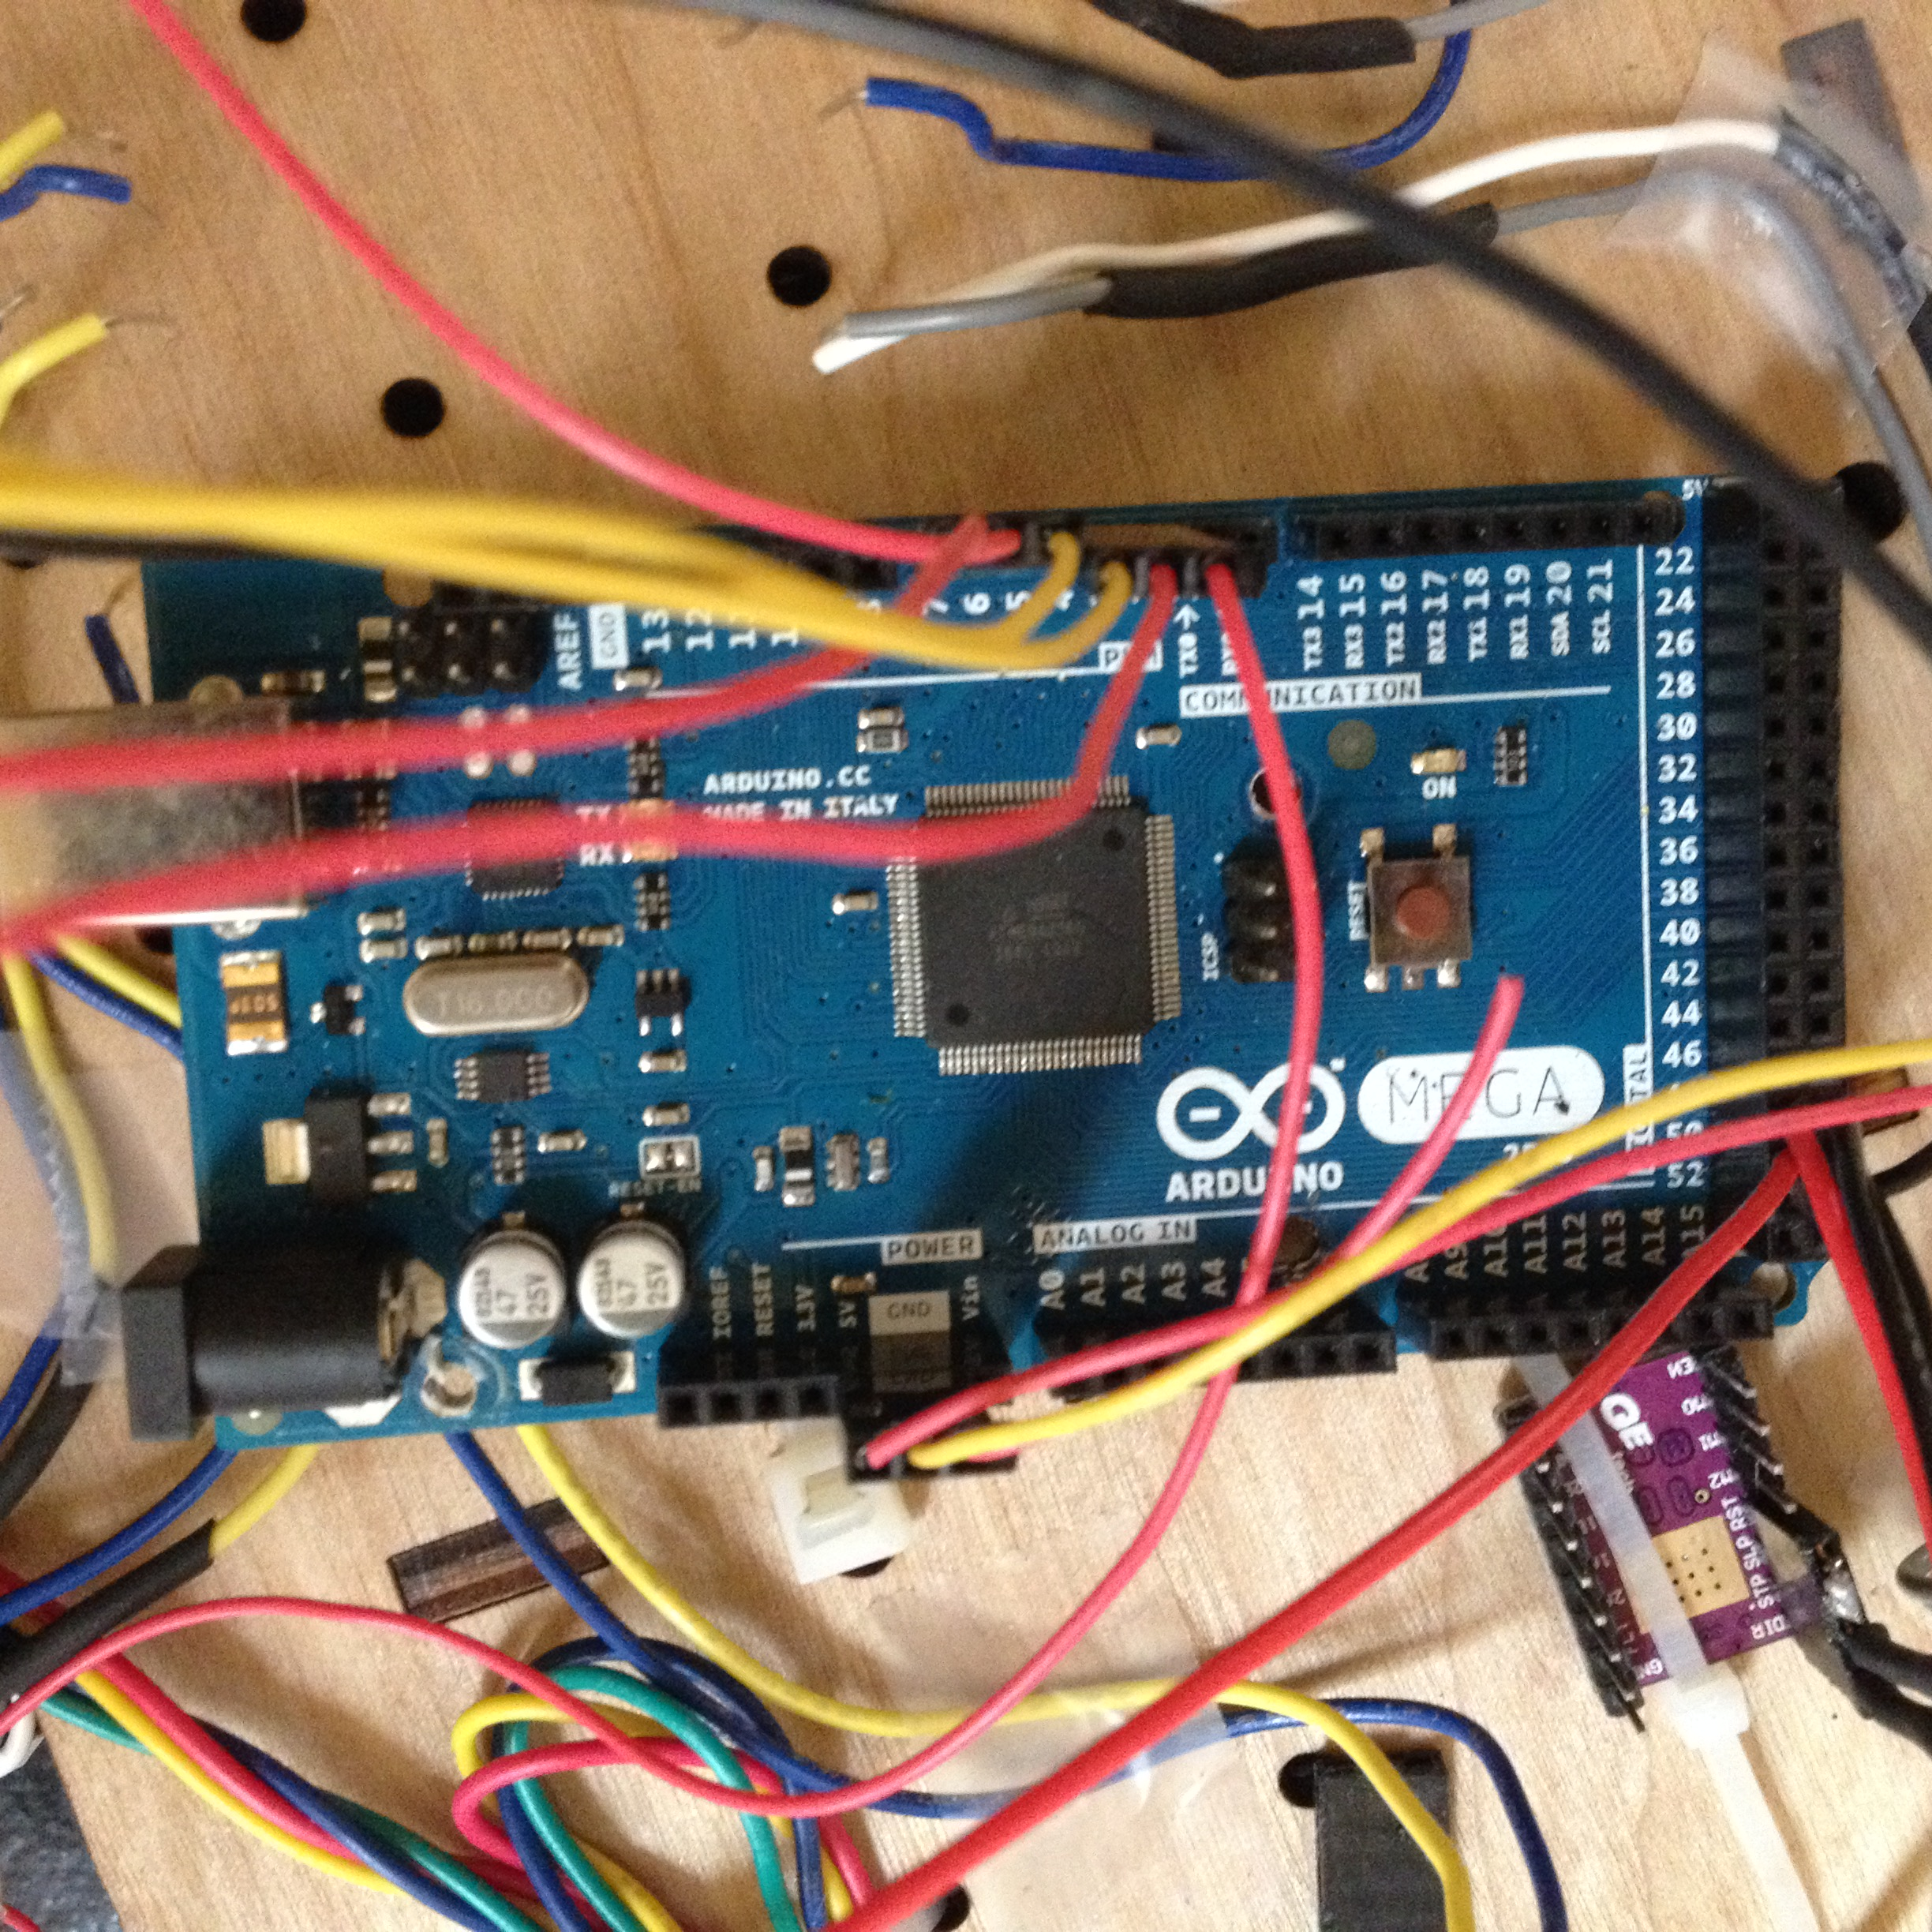
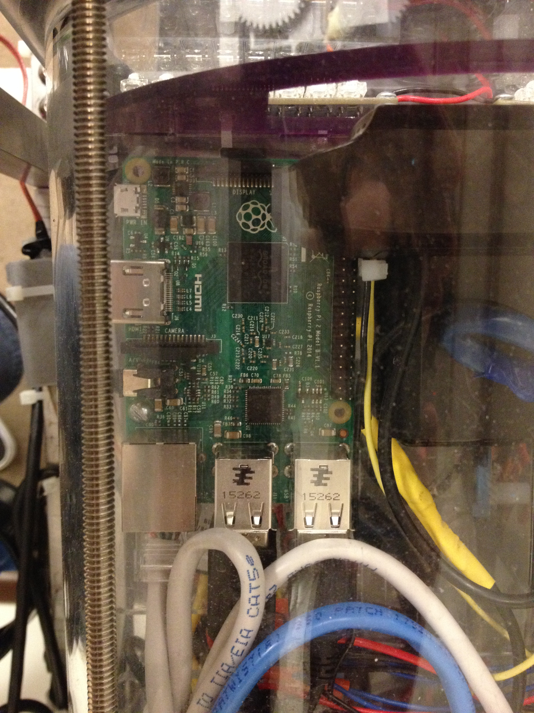
MicroControllers and MicroProcessors
Microcontrollers like Arduino are limited in function but are easy to learn. Arduino uses a proprietary software to make it easy to write code and upload it to the board.
Microprocessers are like little computers, they are more capable than microcontrollers but are also more difficult for the beginning user to work with. Raspberry Pi is one example of a microprocessor. BeagleBone is another.

Slide 11

Additional Duties of the CS Department
Maintain the website(s)

Slide 12
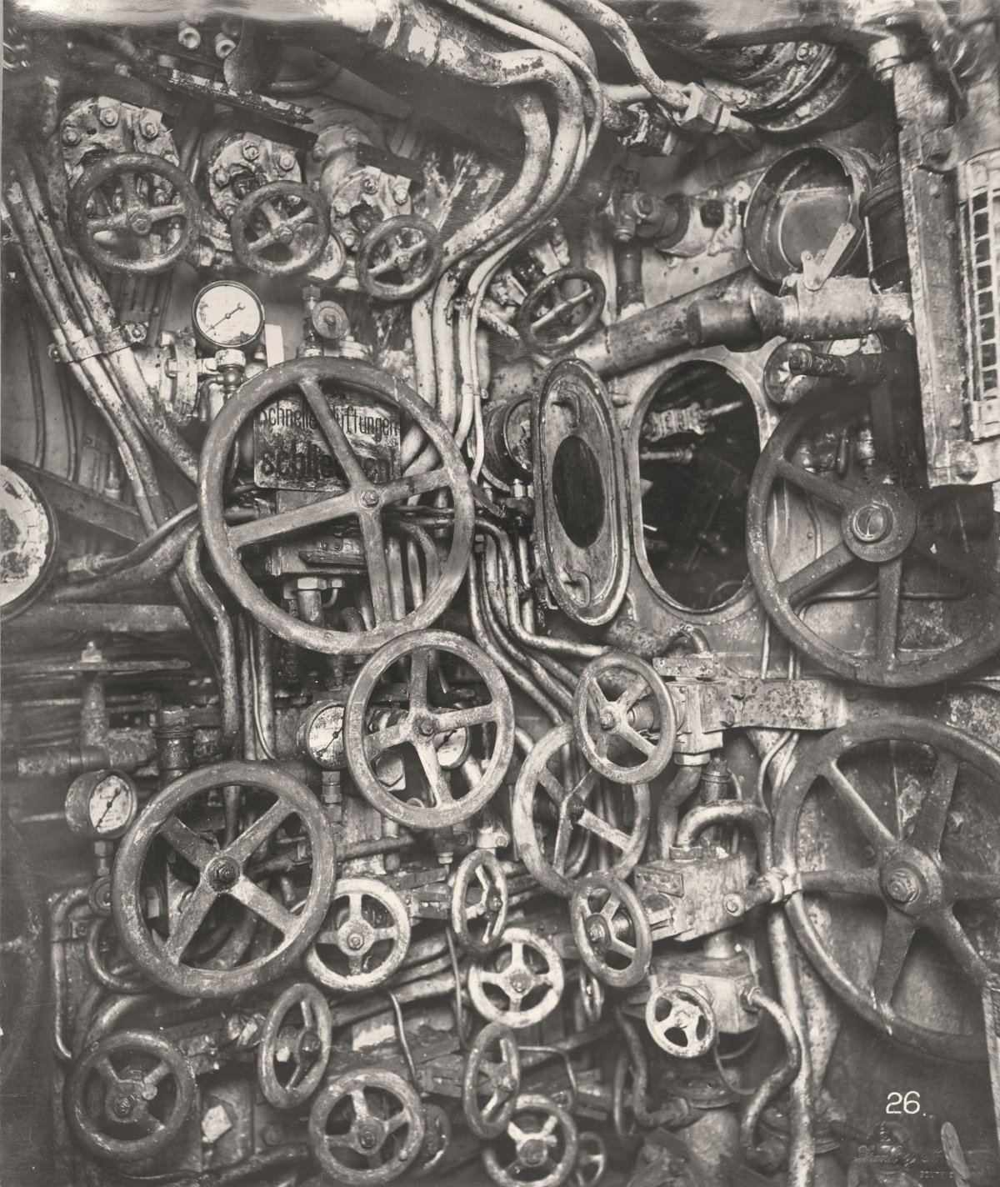
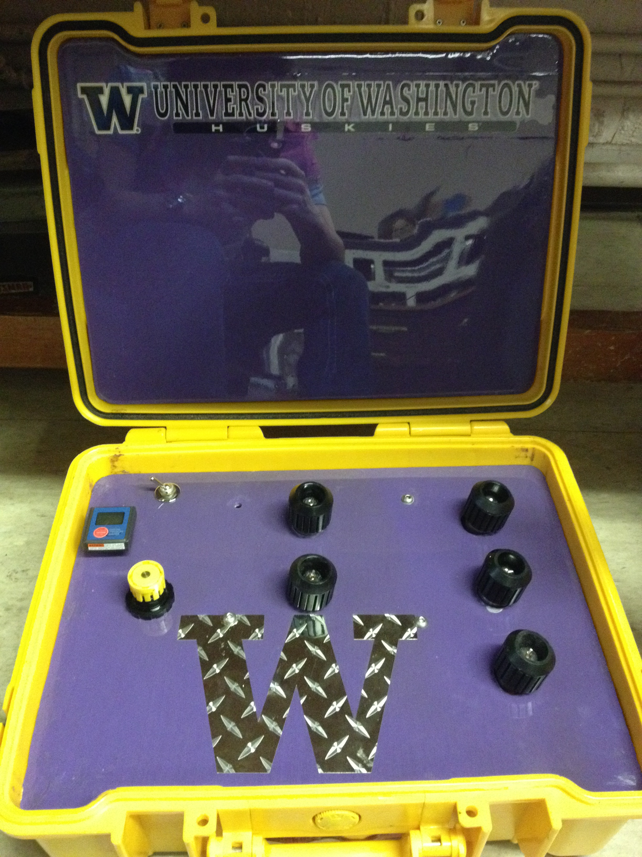
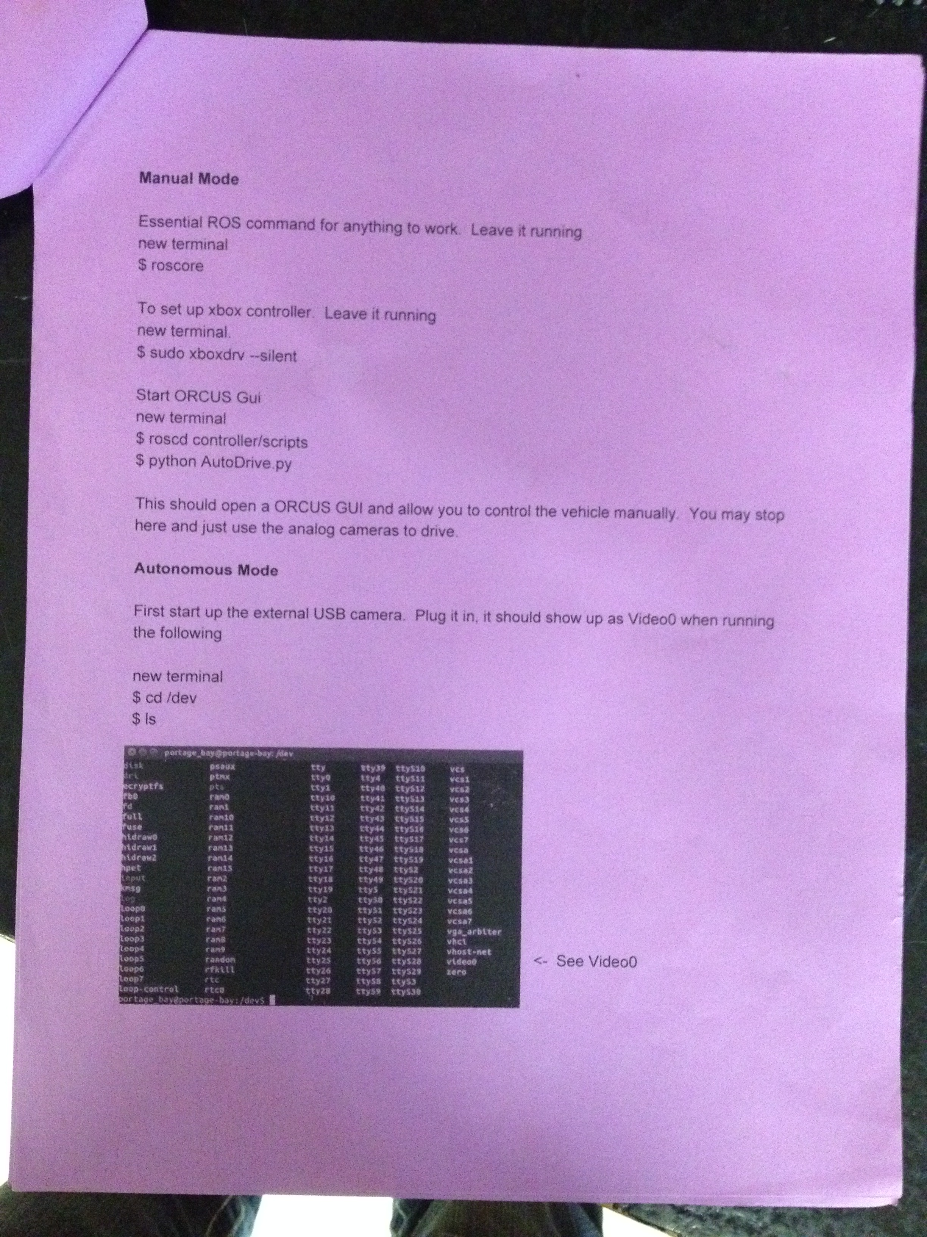
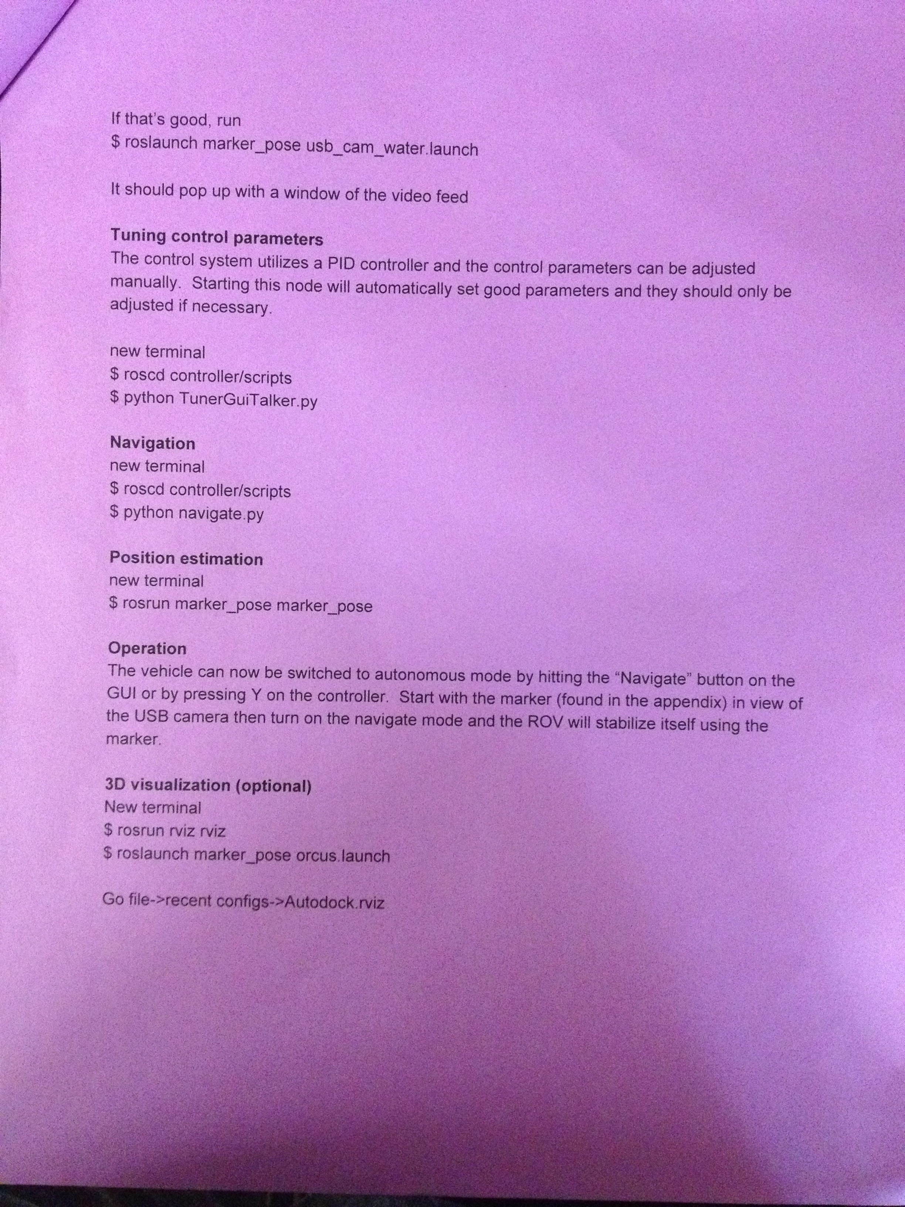
Control Design
Two examples of bad designs which require training: a U-boat from World War 1 and the control system from Admare. These designs lack labels and indicators, which would reduce errors and reduce the required training.
Another example of a design that requires training: the start-up procedure for Orcus that is two pages long. How does someone open the terminal in this operating system?
“If that’s good…”
What if it’s not good?
http://www.businessinsider.com/a-rare-glance-into-the-heart-of-a-wwi-german-u-boat-2015-4/#this-photo-shows-the-manhole-to-the-periscope-hand-wheels-for-pressure-and-valve-gauges-1

Slide 13
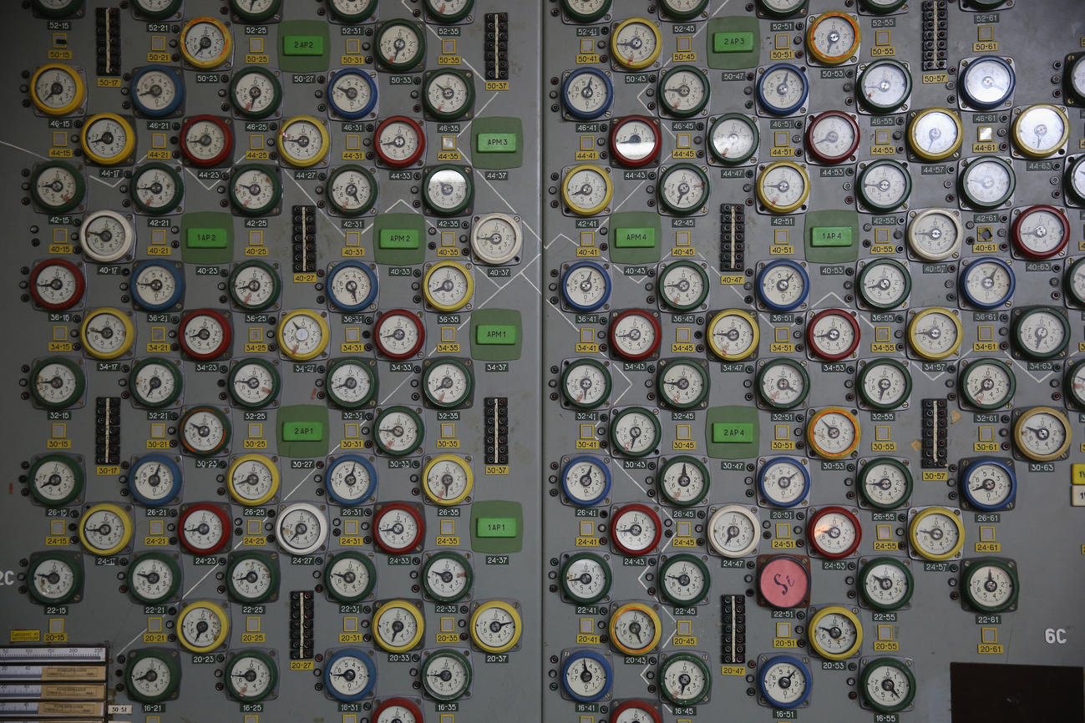
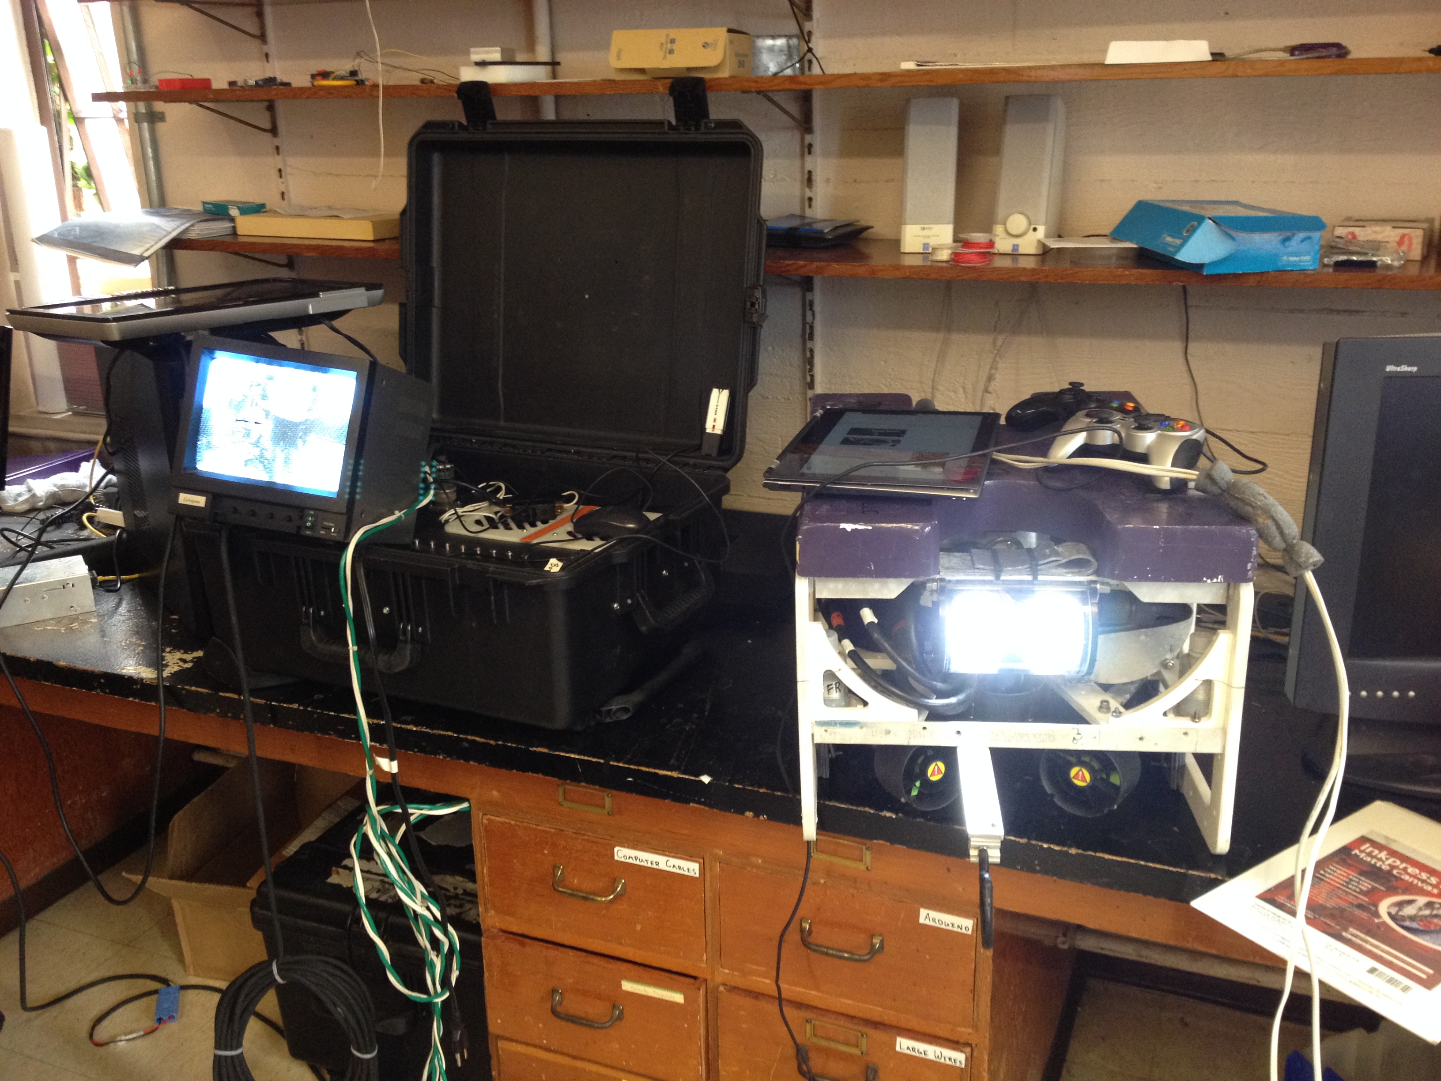
Display Design
One example of a bad design, the gauges of a control room at the Chernobyl power plant (imagine looking for the one giving an unsafe reading).
Another example of a bad design, from Orcus: A tablet is required to run the code, but video must be displayed on Abraham Lincoln’s personal TV monitor, and both must be routed through the Pelican box. Why so much equipment?
http://www.latimes.com/visuals/photography/la-ph-chernobyl-30-years-after-nuclear-power-plant-disaster-20160426-htmlstory.html

